Slide 1


Customer Shopping Behavior Analysis
End-to-end data analytics project demonstrating data cleaning, SQL database design, exploratory analysis, and an interactive Power BI dashboard to surface actionable business insights.
CHETHAN S
B.E. CSE (AI & ML)
TOOLS: PYTHON · SQL · POSTGRESQL · POWER BI

Slide 2


Project Overview
Objective
Extract actionable business insights from raw customer purchase data to improve product strategy and marketing effectiveness.
Scope
End-to-end pipeline: data cleaning, database ingestion, SQL analysis, EDA, and an interactive Power BI dashboard.
Outcome
Delivered KPIs, segmentation, top- product lists, and time-based trends to inform decisions.

Slide 3

Problem Statement
Businesses need clarity on customer buying behavior to prioritize inventory and campaigns.
Difficulty identifying top-performing products and seasonal demand peaks.
Limited visibility into demographic-driven spend and payment preferences.
This project addresses those gaps with data-driven analysis and visualization.

Slide 4
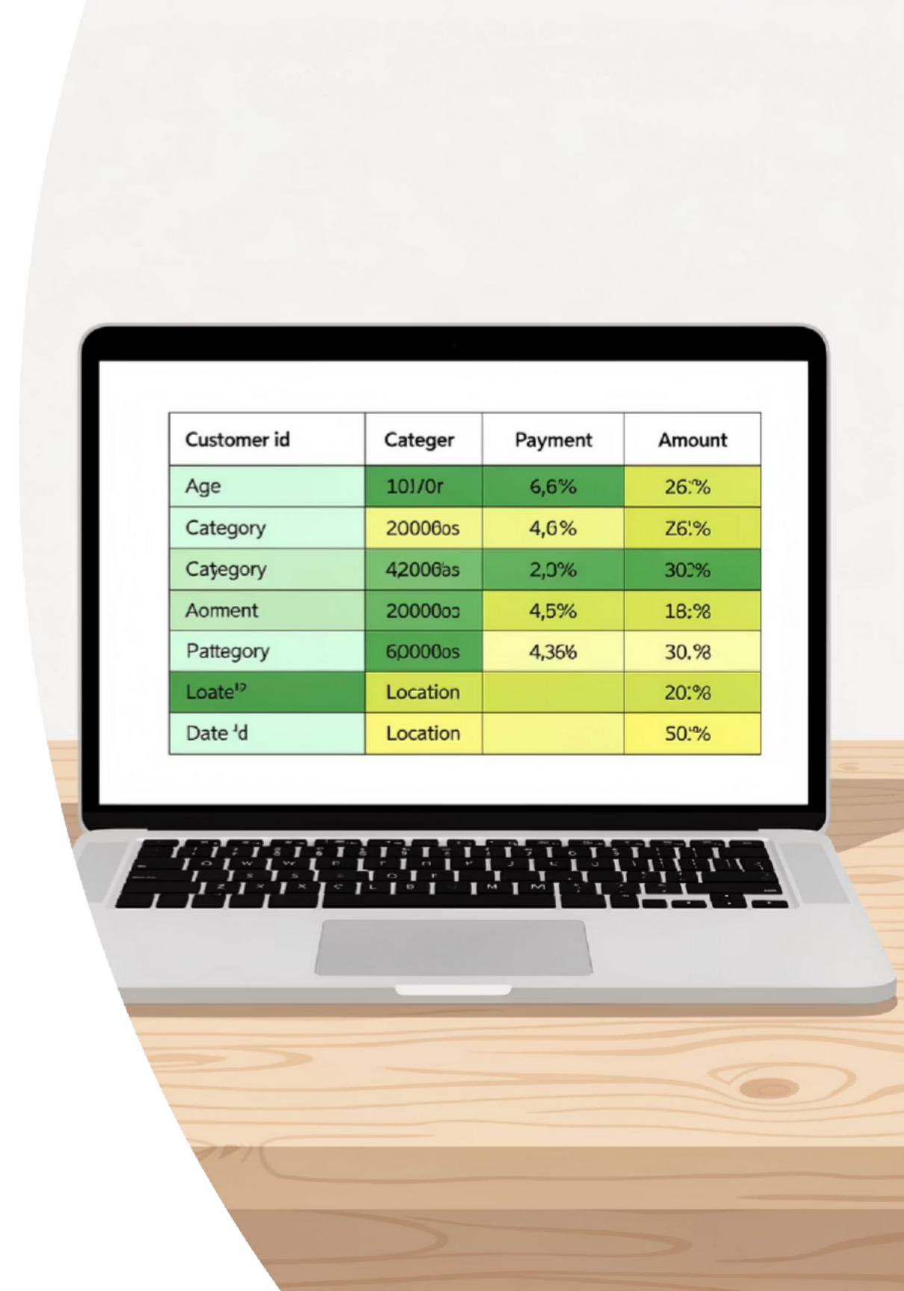
Dataset Description
Core Columns
Preparation Summary
Customer ID · Age · Gender · Product Category · Purchase Amount · Payment Method · Location · Date of Purchase
Removed duplicates
Standardized categories
Normalized location fields
Parsed and indexed dates for time-series analysis
Time range: multiple months — suitable for trend and seasonality analysis.

Slide 5
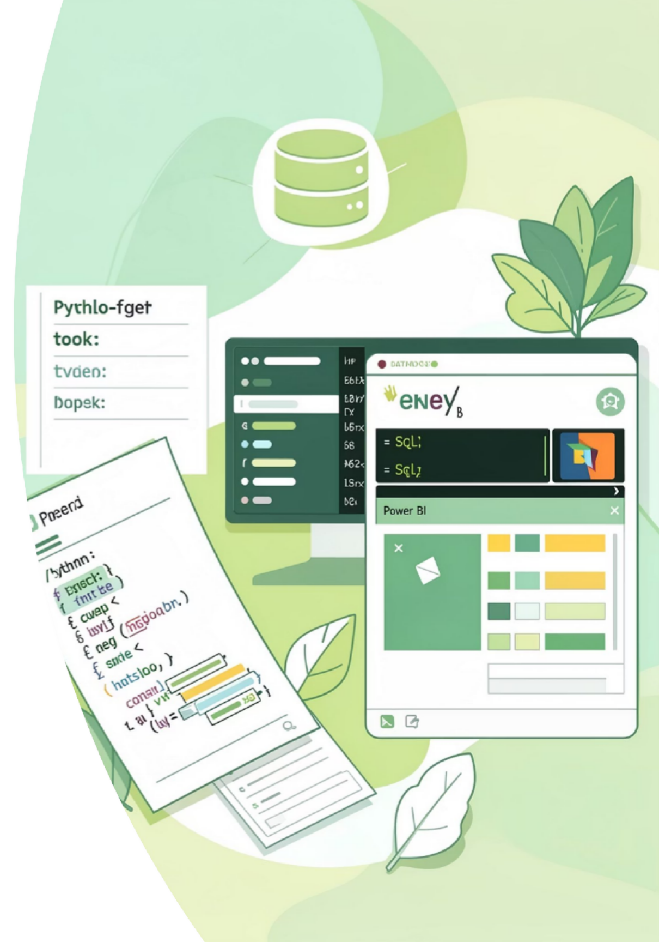



Tools & Technologies
Python
Data cleaning, EDA, scripting, and automation using Pandas and NumPy.
PostgreSQL
Structured storage, indexing, and performant SQL queries for analytics.
Visualization
Matplotlib & Seaborn for exploratory charts; Power BI for interactive dashboards.

Slide 6

Data Cleaning & Preprocessing
Handled missing values with context-aware imputation and flagging for analysis.
Removed duplicate transactions and corrected inconsistent records.
Converted data types, standardized categorical labels, and parsed dates to datetime.
Validation checks for outliers, negative amounts, and location consistency.

Slide 7
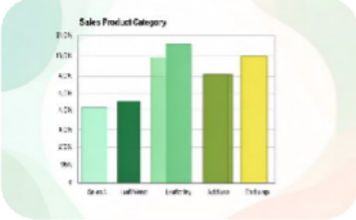
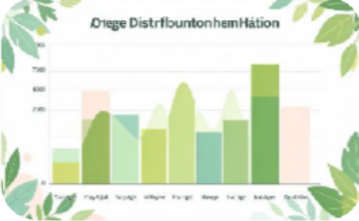
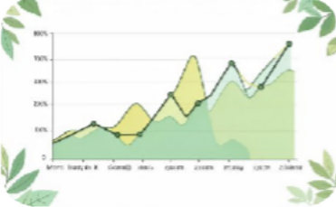
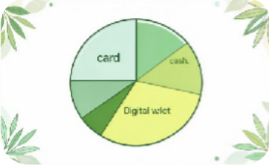
Exploratory Data Analysis (EDA)
Sales by Category
Identified highest-revenue categories and opportunities for cross-sell.
Customer Age Distribution
Two dominant cohorts: 25–34 and 45–54, informing targeted promotions.
Monthly Sales Trends
Payment Method Analysis
Credit/debit cards dominate; digital wallets growing — impacts checkout optimization.
Detected recurring seasonality and a prominent peak month for inventory planning.

Slide 8

SQL & Database Integration
Workflow
Representative Queries
Connected Python ETL scripts to PostgreSQL, loaded cleaned tables, and created indexes for efficient querying.
Total sales and daily revenue trend
Average purchase amount by segment
Top products by revenue and volume
Customer segmentation for targeted campaigns

Slide 9
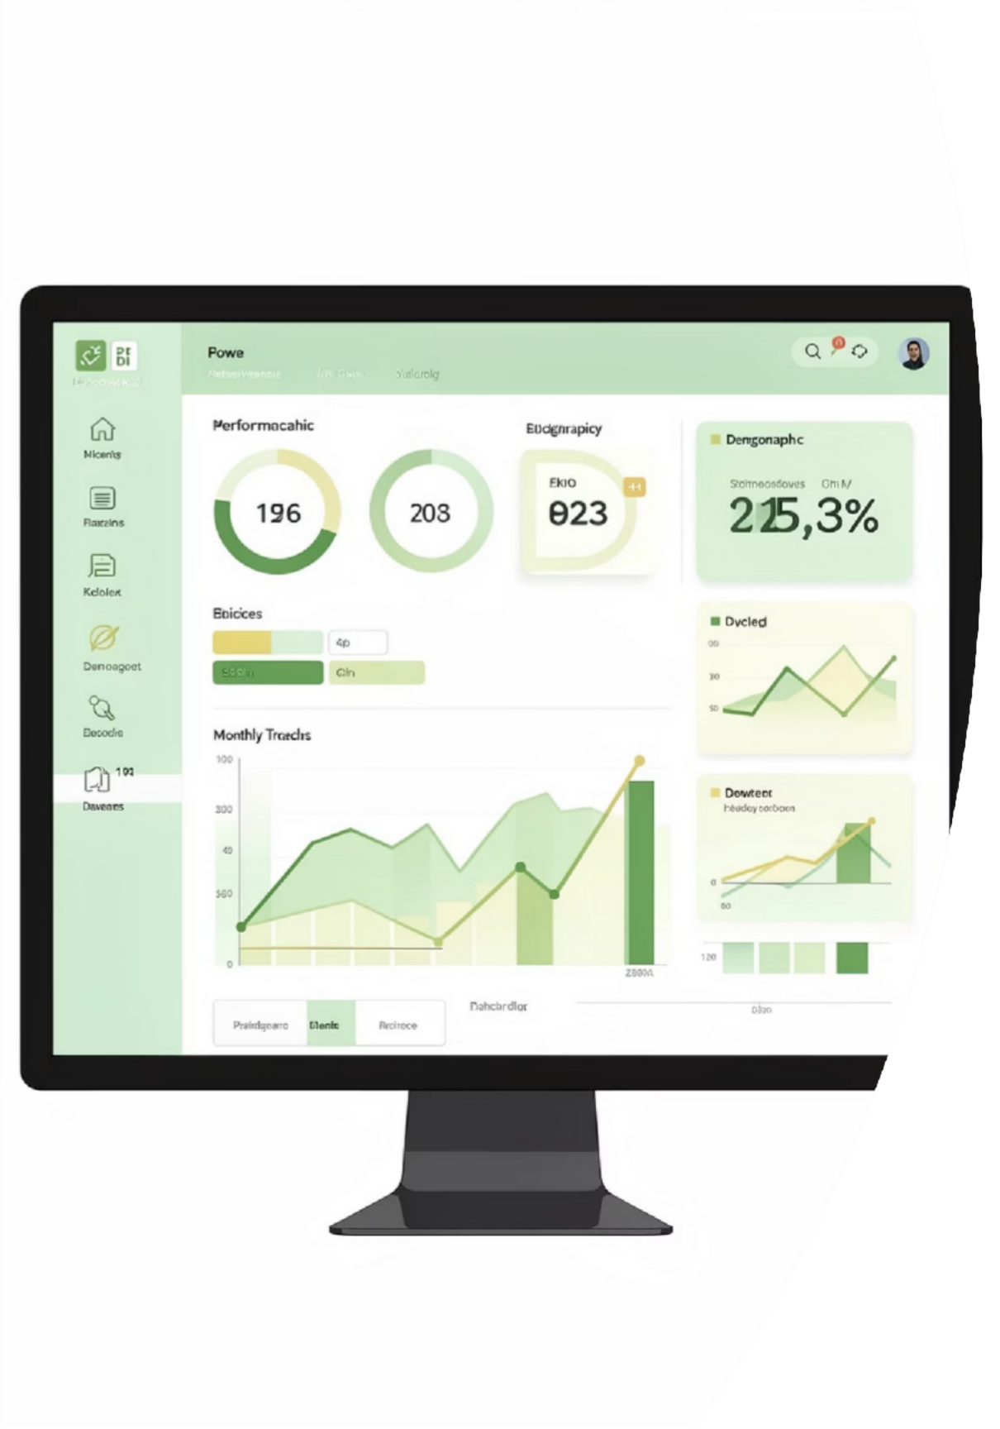
Dashboard Insights (Power BI)
Total Revenue KPI
Real-time revenue, month- over-month growth, and target attainment indicators.
Category Performance
Demographic Insights
Age and gender spending patterns to refine audience targeting.
Category-wise revenue and unit sales with drill- through to product-level detail.
Interactive Filters
Slicers for date range, location, payment method, and customer segment for on-the-fly analysis.

Slide 10

Conclusion & Key Outcomes
Delivered an end-to-end analytics solution that identified top-performing products, uncovered peak sales periods, and revealed demographic spending patterns. Recommendations include inventory reallocation during peak months, targeted promotions for high- value cohorts, and checkout optimizations for rising digital payments. The project proves capability in data engineering, analysis, and dashboard storytelling.
NEXT STEPS
A/B TEST PROMOTIONS · DEPLOY REAL-TIME ALERTS · EXPAND DATASET FOR CLV MODELING

